Slide 1
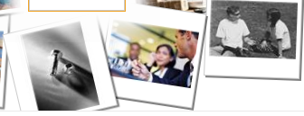
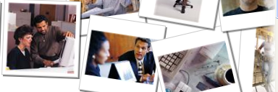
Credential Acceleration and
Support for Employment (CASE)
An Oregon Consortium
Clackamas Community College
The fiscal agent, on behalf of Oregon ‘s 17 community colleges

Slide 2
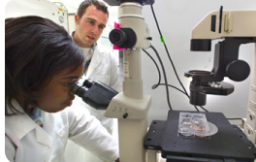
The Purpose of CASE …
Is in response to:
Oregon’s Joint Boards of Education’s 40/40/20 goal
The need to accelerate workforce readiness, industry credentialing, and time to program completion for the Trade Act and other community college students
Achievement Compacts Our funding will be associated with our outcomes and completions; CASE is a method to get ready
And, to promote change through building stronger partnerships united by a core belief that industry-recognized and postsecondary credentials are the gateway to high-wage, high-demand jobs, and is the foundation for Oregon’s economic success
…is to help advance and secure the economic prosperity of Oregon through partnership building across sectors.
Notes:
additional statewide impacts like shared best practices from the 3-C's, perhaps lead toward standardization between colleges to benefit and better serve students as they move around the state, and this project has positional to be a transformational in Oregon.

Slide 3
Case partners join together…
All 17 Community Colleges
All 7 Local Workforce Investment Boards (WICCO)
Oregon Employment Department/Trade Act
Employers
Community Partners
Oregon Department of Community College and Workforce Development
…and create a statewide CASE Consortium.

Slide 4
The CASE Model identifies and addresses
Do you know why:
Most TAA-eligible folks do not enroll in training?
Students in training programs do not complete?
Many unemployed individuals are not ready for skills training?
Student’s don’t use Credit for Prior Learning?
Veterans aren’t getting transcription of military training?
There are limited short-term Career Pathways Certificates?
Data and communication systems between college, Workforce Investment Act (WIA), and TAA staff are not shared for referral, support and/or tracking of shared clients?
Rural and frontier students face barriers to industry-recognized credentials postsecondary attainment?
...significant gaps in educational and career training.
Notes:
Most TAA-eligible folks do not enroll in training
Many students entering training programs do not persist to completion
Many unemployed individuals do not have the basic skills needed to succeed in training
Credit for Prior Learning is not well defined or utilized
Career Pathways Certificates have not been developed for all demand occupation

Slide 5
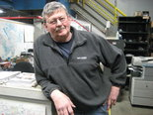
CASE Impacts Personal Stories…Personal Lives
Bobby Allyn/The Oregonian:
“Most people don't know where
they're going to go next," said
Molalla resident Steve Helgerson,
61 years old, a storeroom
supervisor who worked at the Blue
Heron mill for 23 years. "If you lost
your job in today's market, where are you going to go?"
I worked at Blue Heron Paper Company along with 175 others whose work history goes back decades and generations. In Feb. 2011, with 2 days’ notice, the mill shut down, no medical, no vacation pay, and no severance. 175 families were out in the cold.
--Jon LaFarge, Former 1 & 4 Stock Prep Operator

Slide 6
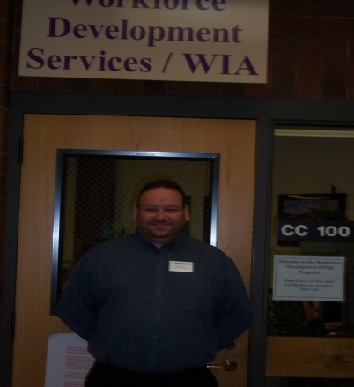
Personal Stories…Personal Lives
I was employed at the paper mill in Oregon City for almost 42 years, and was laid-off in February 2011 when the mill shut down unexpectedly.
After working in the same place for that long and then being without work, it is very unnerving. I had no idea what to expect, where to go or what I needed to do to either look for a job or find training in another field. - Leon Martinot
Mike Lutz – dislocated worker from Cleanpak Trade Act plant shutdown; temporarily serving as a Workforce Advisor
“After the company I worked at, CleanPak, closed down I didn't know what I was going to do.” - Cassie Davis

Slide 7
CASE uses a ‘Three C’ strategy approach…
Career Pathways
Career Coaches
A “Portable” approach to granting
Credit for Prior Learning (CPL)
…that links directly to the TAACCCT SGA and is in response to the identified gaps and weaknesses in the system.
Notes:
Expand and enhance Career Pathways as a vehicle to increase credential completion and accelerate time to completion
Develop through training Career Coaches to reduce barriers so that students enroll, persist, complete a credential, and secure employment in a demand occupation
Launch development of a “portable” approach to granting Credit for Prior Learning (CPL)
For students and workers

Slide 8
The first ‘C’…. Career Pathways
The Goal: Build short-term programs that meet industry needs faster
The Strategy: Offer Career Pathway Certificate programs for emerging and demand occupations based on industry-driven competencies
The Outcome:
Create new career pathway certificates
Enhance existing career pathway programs
Notes:
The Goal: Build Programs that Meet Industry Needs
The Strategy: Offer Career Pathway Certificate programs for emerging and demand occupations based on industry-driven competencies
The Outcome:
Create new career pathway certificates
Enhance existing career pathway programs

Slide 9
The second ‘C’…. Career Coaches
The Goal: Engage more dislocated workers and accelerate progress for low-skilled and other workers
The Strategy: Provide enhanced student services through Career Coaches focused on student enrollment, completion, credential attainment and employment in demand occupations
The Outcome by September of 2014:
514 students start training and 437 earn a credential
85% of students complete
285 students get a job (65% of those who finish)
228 students keep their job at least 2 quarters (80%)
Notes:
Strategy
– target workers who need to increase their adult basic skills and/or English language skills to enter CTE programs
- Unemployed and underemployed workers who need to upgrade their skills and advance in their career path

Slide 10
The third ‘C’…. Credit for Prior Learning
The Goal: Improve retention, achievement rates and to expedite time to completion and placement
The Strategy: Increase understanding and use of Credit for Prior Learning (CPL) within and between Oregon’s community colleges; pilot transcription of military training
The Outcome:
During year 1 of the grant a ‘Community of Practice’ (COP) consisting of 5 colleges will pilot a program that increases integration of CPL strategies aligned with national standards
The COP will share best practices and create a ‘portable e-portfolio ‘ that is adapted and accepted between colleges
All colleges will participate in quarterly COP meeting to build capacity

Slide 11
Thank you!
For further information contact:
Contact a Career Coach mycareercoach@clackamas.edu 503-406-8758 (call or text)
John Kyllo: johnk@clackamas.edu 503.594.3436 Kara Leonard: kleonard@clackamas.edu 503.594.6130 Molly Dorney: mdorney@clackamas.edu 503.594.6127

